Slide 1
How to hide information in Windows?
by Volodymyr Zolotukhin

Slide 2

Steganography is the practice of concealing a file, message,
image, or video within another file, message, image, or video.

Slide 3
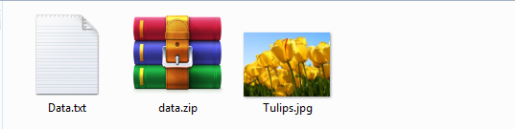
Step 1
Create an archive with information
Choose a picture

Slide 4
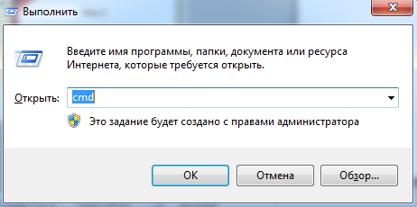
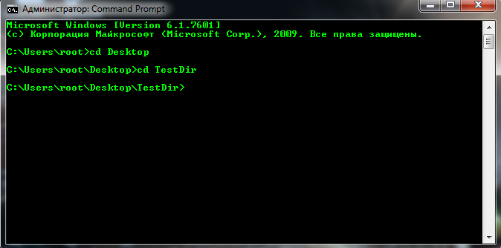
Step 2
Open the console by pressing win + R and typing "cmd"
Go to the folder with prepared files

Slide 5

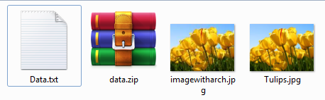
Step 3
Enter into the console "copy / b image.jpg + archive.zip imagewitharch.jpg",
where image.jpg is the original image, archive.zip is the archive with data,
imagewitharch.jpg is the name of the resulting file
And in the folder we can see

Slide 6
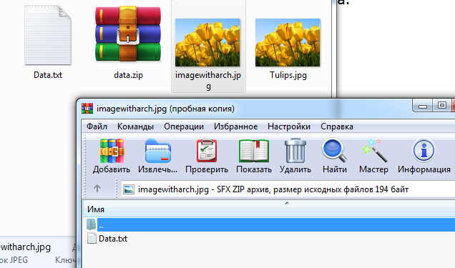
Step 4
It looks like an ordinary picture, but if we open the
file as an archive,we can get hidden data.

Slide 7
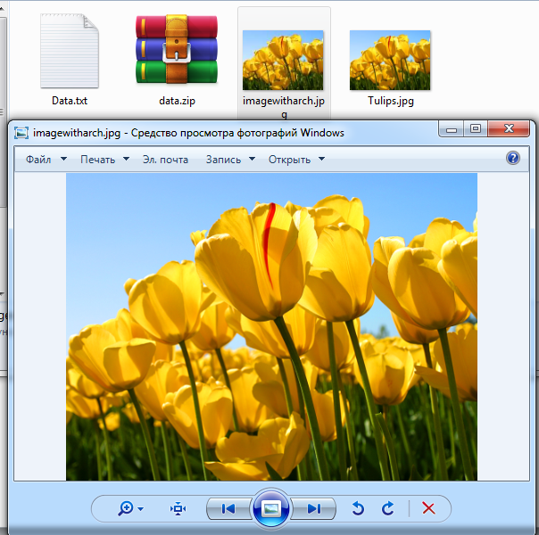
Result
And, of course, if we open it as a picture, we will see a picture

